Slide 1


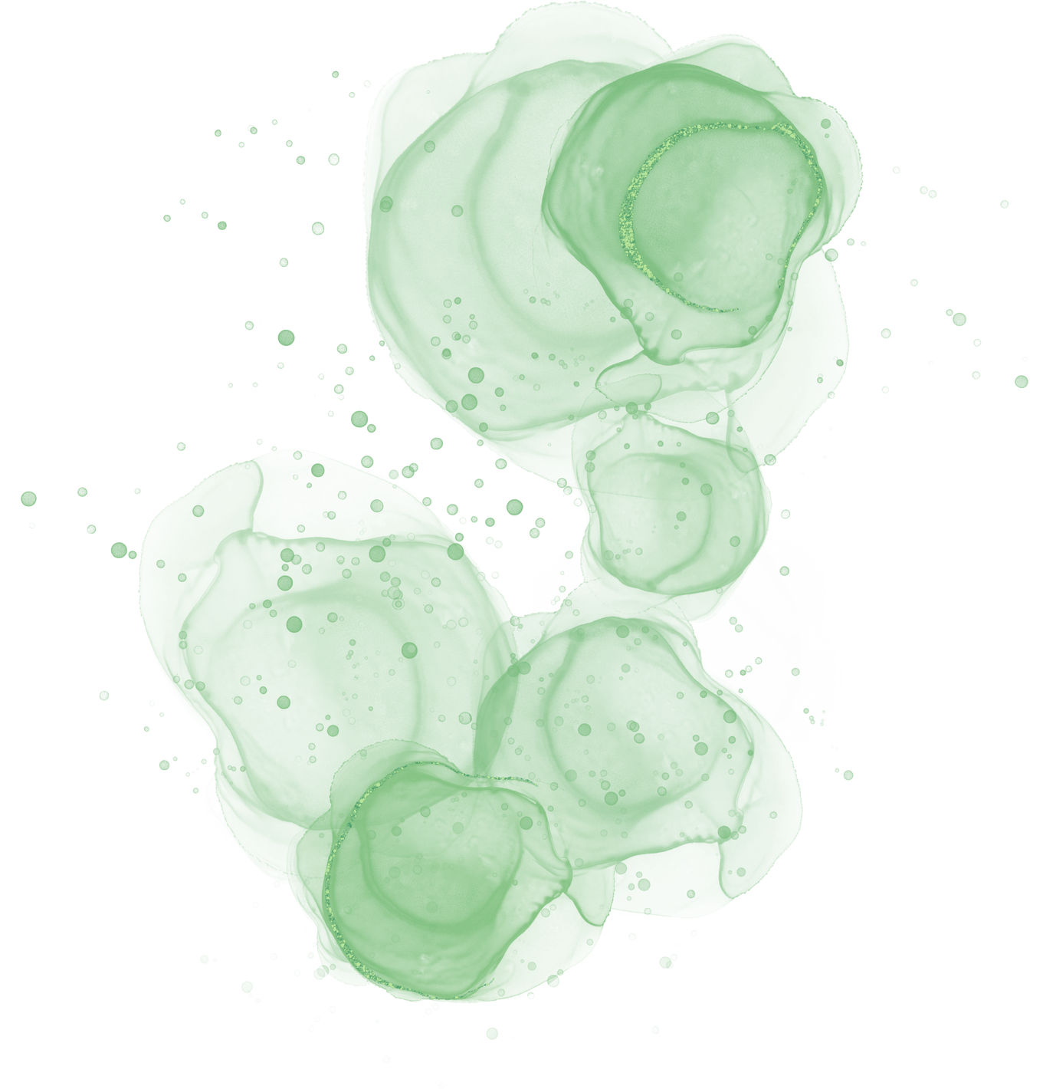








DYNAMIC FOOTBALL TRANSFER VALUE PREDICTOIN
M.TEJA RAMA SAI

Slide 2



Overview
Player transfer markets are a vital aspect of professional sports, influencing team dynamics and competitive success. Estimating a player’s transfer value is a complex task that depends on various factors such as performance, age, team, public sentiment, and market trends. In this project we propose the development of an AI driven model that predicts player transfer values by integrating multi-source data including player performance statistics, social media sentiment, injury history and historical market data. By using advanced machine learning and time-series forecasting techniques, this project will provide a dynamic, data-driven approach to predicting player transfer values.

Slide 3
PROJECT FORMAT
INTRODUCTION
ML PILELINE
METHODOLOGY
DATA COLLECTION
FEATURE ENGINEERING
TYPES OF MODELS
SELECTED MODEL(LIGHTBGM)
REPRESENTATION
REASONS
BOUNDARYS
REFERENCES

Slide 4
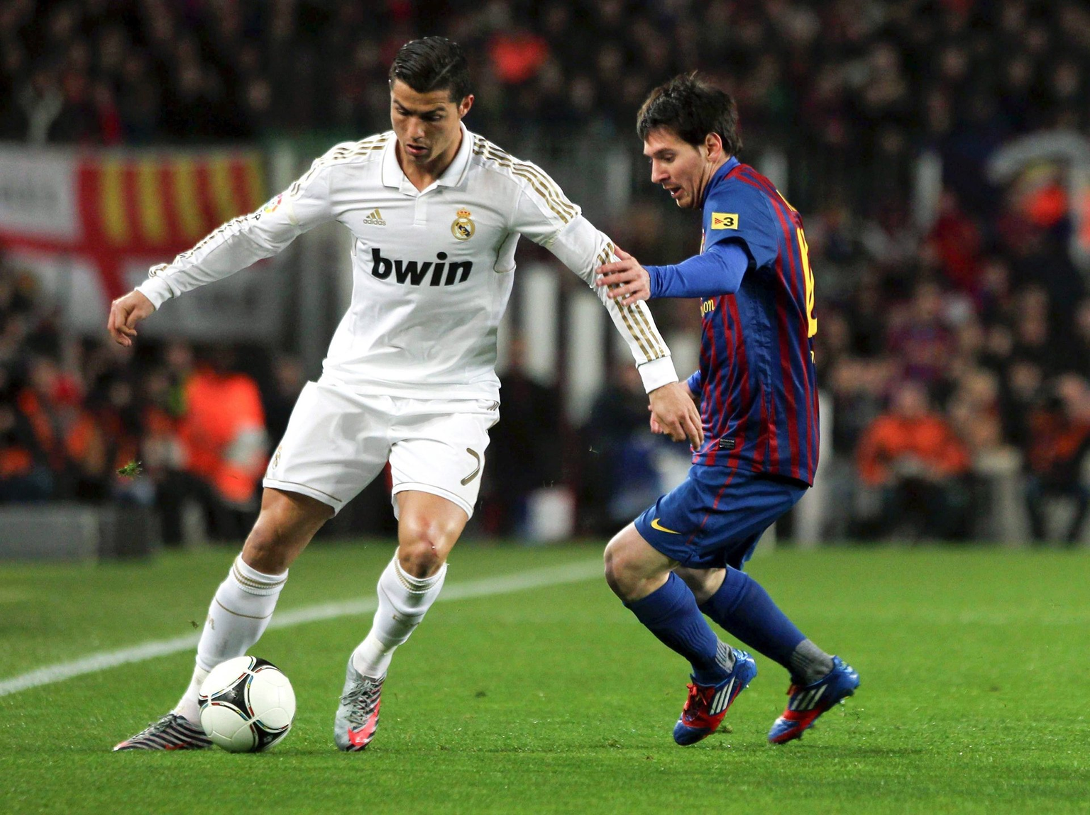
INTRODUCTION
Player transfer markets are a vital aspect of professional sports, influencing team dynamics and competitive success. Estimating a player’s transfer value is a complex task that depends on various factors such as performance, age, team, public sentiment, and market trends. In this project we propose the development of an AI driven model that predicts player transfer values by integrating multi-source data including player performance statistics, social media sentiment, injury history and historical market data. By using advanced machine learning and time-series forecasting techniques, this project will provide a dynamic, data-driven approach to predicting player transfer values.

Slide 5
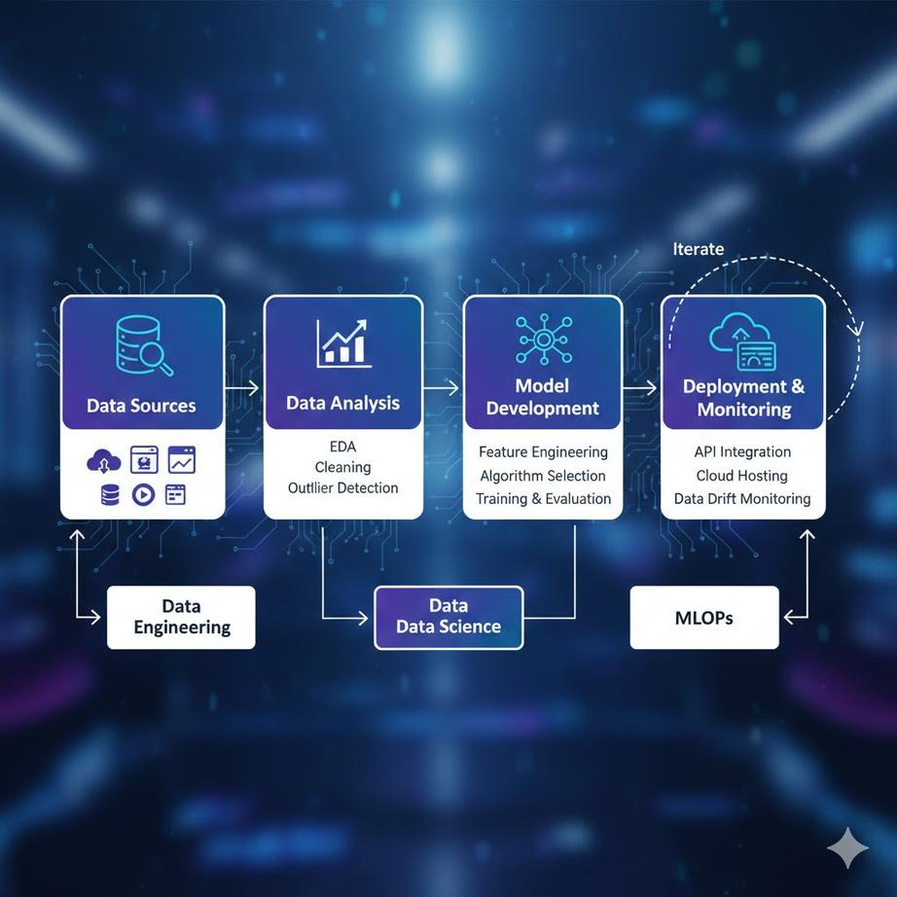
Machine Learning Pipeline
Stage | Main Goal | Key Activity
Data Sources | Acquisition | Extraction & Loading
Data Analysis | Understanding | Cleaning & Visualization
Model Development | Intelligence | Training & Evaluation
Deployment | Value | Integration & Monitoring

Slide 6

METHODOLOGY

Slide 7
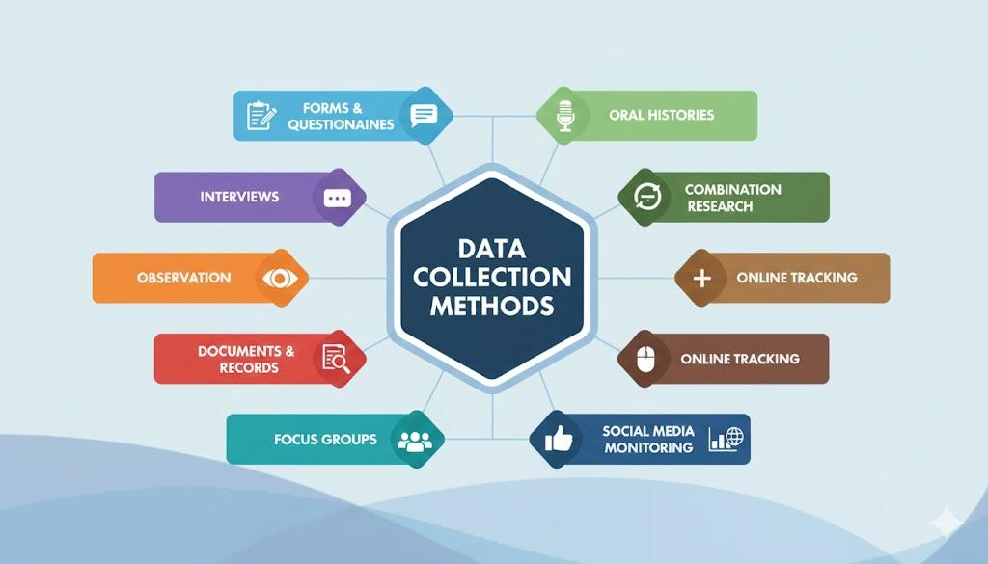
DATA COLLECTION

Slide 8
FEATURE ENGINEERING

Slide 9
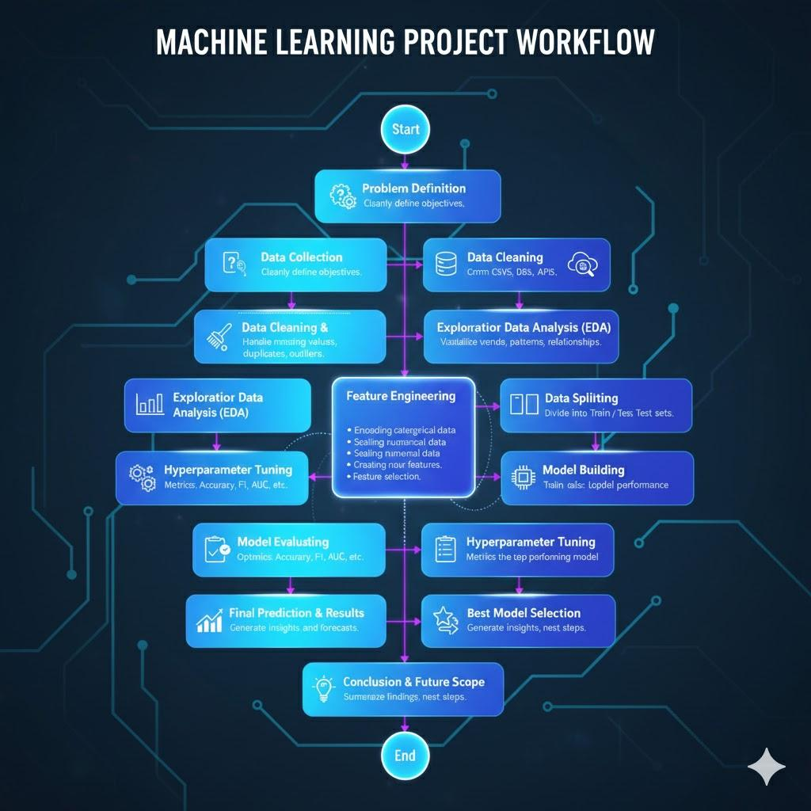
FEATURE ENGINEERING

Slide 10
TYPES OF MODALS

Slide 11

MODALS
1. Logistic Regression
2. Random Forest
3.LightGBM (selected)
4. CatBoost

Slide 12
LIGHTGBM
LightGBM (Light Gradient Boosting Machine) is a boosting-based machine learning algorithm that builds multiple decision trees sequentially to improve prediction accuracy.

Slide 13

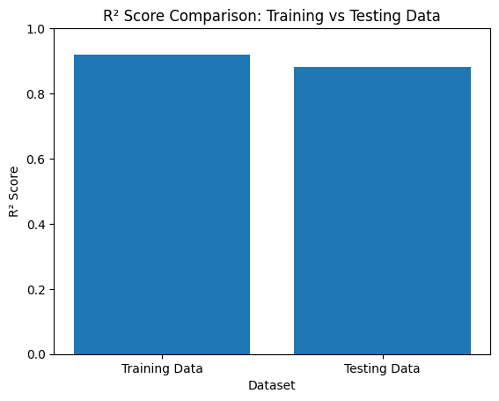
GRAPHICAL REPRESENTATION

Slide 14
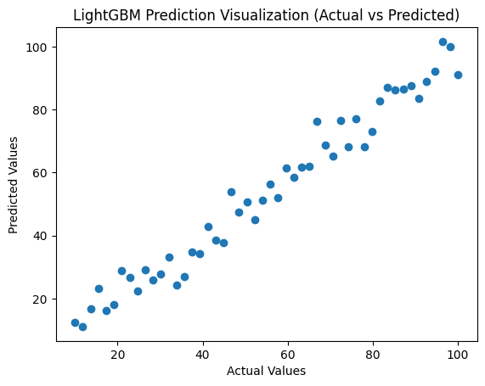
SCATTER PLOT VISUALIZATION FOR LIGHTGBM (ACTUAL VS PREDICTED VALUES)
Timeline

Slide 15

01
Training R² = 0.92 → The model fits the training data very well
REASONS
02
Testing R² = 0.88 → The model also performs well on unseen data
03
The small gap between training and testing shows good generalization

Slide 16

Boundaries of the project
Performance depends on data quality ,Risk of overfitting with poor tuning,Limited interpretability,
High computational cost,
Not tested in real-time systems

Slide 17
References
Transfermarkt GmbH: Comprehensive database covering football player market valuations, transfer histories, and contract details.
FIFA and Domestic League Data Providers: Official sources of match data, including player and team performance statistics across competitions.
Pedregosa et al.: Scikit-learn: Machine Learning in Python, Journal of Machine Learning Research — a widely used Python library for machine learning and data analysis.
Ke et al.: LightGBM: A Highly Efficient Gradient Boosting Decision Tree, NeurIPS — an optimized framework for high-performance gradient boosting models.
Lundberg, S. M., & Lee, S. I.: A Unified Approach to Interpreting Model Predictions (SHAP), NeurIPS — a method for explaining and interpreting machine learning model outputs.
Twitter (X) API Documentation: Access to public social media data for sentiment analysis and trend detection.
Streamlit Documentation: Framework for building and deploying interactive web applications for machine learning models.

Slide 18
THANK YOU
M.TEJA RAMA SAI

